Slide 1
Vorticity

Slide 2
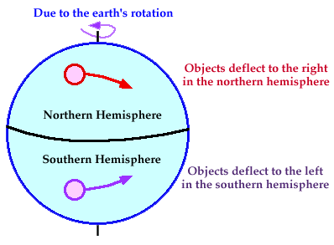
Vorticity
The vorticity describes the local spinning motion of a fluid near some point.
Vorticity can be thought of simply as a COUNTER-CLOCKWISE or CLOCKWISE spin.
Low pressure is associated with rising air and high pressure with sinking air.
Counterclockwise spin produces POSITIVE VORTICITY while a clockwise spin in the Northern Hemisphere produces NEGATIVE VORTICITY.

Slide 3
Elements that produce vorticity
SHEAR
CURVATURE
CORIOLIS
SHEAR- A change in wind speed over some horizontal distance. Determined at 500 millibars by examining the spacing (and rate of spacing change) of height contours.
CURVATURE- A change in wind direction over some horizontal distance. This change will result in either a counter-clockwise or clockwise curvature.
CORIOLIS - Coriolis is the spinning motion created by the Earth's rotation.
Absolute vorticity = shear + curvature + coriolis

Slide 4
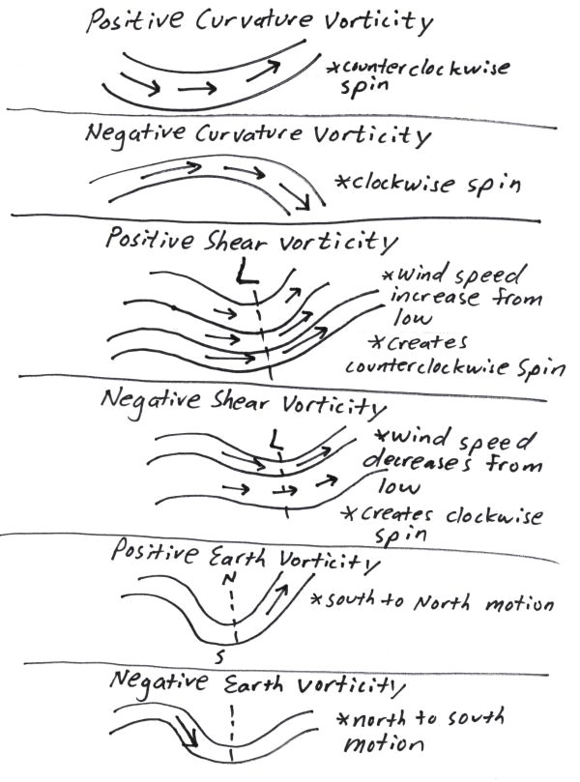
POSITIVE / INCREASING VORTICITY Wind speed increasing when moving away from center point of trough. (positive shear vorticity)
A counterclockwise curvature in the wind flow. This occurs in troughs and shortwaves. (positive curvature vorticity)
A south to north movement of air. Coriolis increases (becomes more positive) when moving from the equator toward the poles. (increasingly positive earth vorticity)

Slide 5
NEGATIVE / DECREASING VORTICITY Wind speed decreasing when moving away from center point of trough. (negative shear vorticity)
A clockwise curvature in the wind flow. This occurs in ridges. (negative curvature vorticity)
A north to south movement of air. Coriolis decreases (becomes less positive) when moving from the pole to the equator. (decreasingly positive earth vorticity)

